Slide 1

ROUND TABLE Informations & Questionaire
CEM 2020 Workshop (online)
2-4 november 2020

Slide 2
Letter of 15 EU Member States on EMF and 5G disinformation from 20.10.2020
concerning disinformation about 5G, was sent to the EU. The initiator of the letter was the government of Poland. Support for the initiative was provided by 14 EU countries and, including Poland, 15 countries penned the letter: Austria, Bulgaria, Croatia, Czech Republic, Cyprus, Estonia, Finland, Greece, Latvia, Lithuania, Luxembourg, Poland, Portugal, Slovakia, and Sweden.
The EU countries that were not involved in the letter: Belgium, Denmark, France, Germany, Hungary, Ireland, Italy, Malta, Netherlands, Romania, Slovenia, and Spain.

Slide 3
Press Conference: WASHINGTON, DC, 20.10. 2020 Organized by EHT (Environmental Health Trust)
The FCC Misrepresents Scientific Facts and US Agency Positions
U.S. Court of Appeals for the District of Columbia against
The FCC’s decision not to update its 1996 wireless exposure limits and for it’s refusal to adopt science based cell phone/tower and wireless exposure rules that adequately protect the public from biological effects.

Slide 4
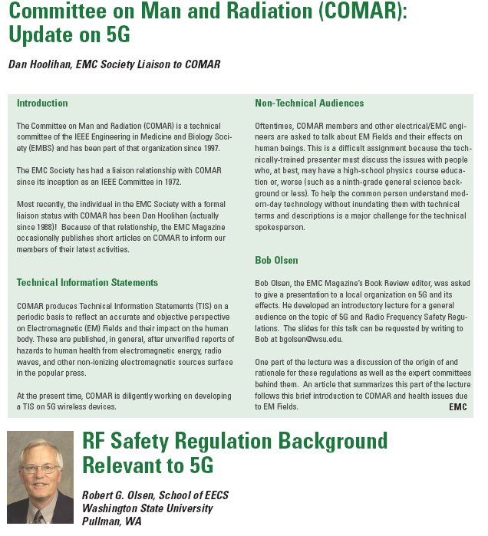

Slide 5
Videoconferinţa ZF-21. 07. 2020 Ce planuri are România cu tehnologia 5G?
Ce performanţe vor avea reţelele 5G din România dacă operatorii nu vor avea acces la spectrul de frecvenţe radio necesar?
Cât timp va mai fi România în topul ţărilor cu cel mai rapid internet din lume dacă nu va avea reţele 5G construite la întreaga lor capacitate?
Ce aspecte îşi doresc operatorii de telecom să fie clarificate de către autorităţi în perspectiva licitaţiei 5G?
Ce aspecte îşi doresc furnizorii de echipamente şi de servicii pentru operatorii de telecom să fie clarificate de către autorităţi în perspectiva licitaţiei 5G?
Având în vedere birocraţia sufocantă din domeniul construcţiei de infrastructură de comunicaţii, este realist să ne aşteptăm ca operatorii de telecom să poată construi rapid reţele 5G dacă legislaţia nu se schimbă? Ce ar trebui făcut / schimbat în primul rând?
Pe ce ar trebui să se bazeze deciziile de a permite accesul la construcţia reţelelor 5G al anumitor companii / furnizori de echipamente şi servicii? Care este abordarea autorităţilor din România în acest caz?

Slide 6
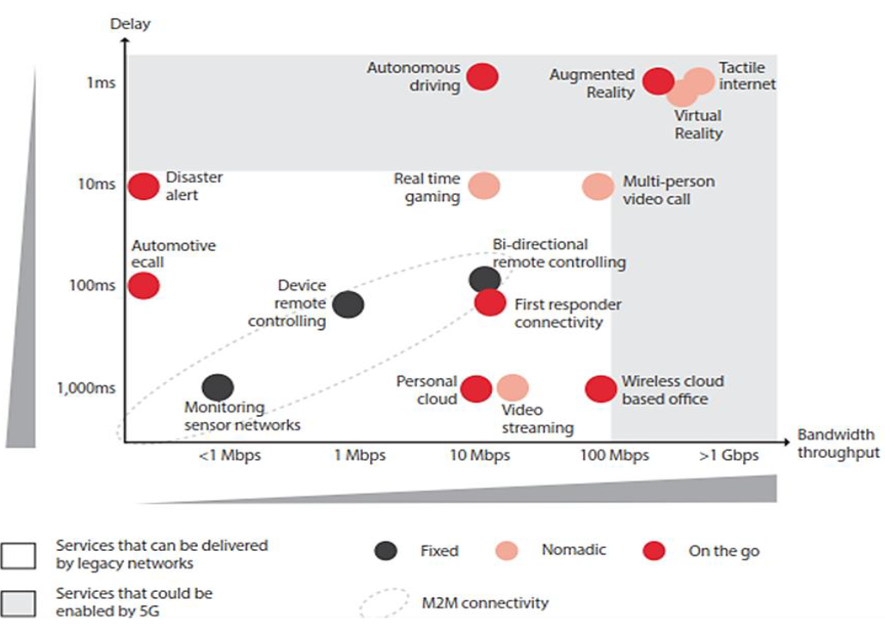
5G Conference Cluj-Napoca 11.09.2020 The impact of 5G on the health of the population
5G – Data speed and latency

Slide 7
Conferinţa online 5G INDUSTRIAL 2020 25.09.2020 România “Şansele unei economii accelerate de IoT, WiFi, Cloud, 5G”
1. Ioan DEMETER, MobiSoft: În UK, OFCOM, echivalentul ANCOM, cere 980 £ pe 3 ani pentru o licență 5G
2. Nicolae Oacă: Lungul drum al României către tehnologia 5G. Soluții pentru depășirea impasului
Ce frecvențe 5G vor fi folosite în România?
ANCOM ofera benzile 700 MHz, 800 MHz, 1500 MHz, 2600 MHz şi 3400-3800 MHz
Cine ofera servicii 5G in Romania: Vodafone, DIGI.Mobil, Telekom, Orange

Slide 8
Information about the Campaign against the 5G System from Romania
Discussion in the Romanian Parliament https://ziaristii.com/delir-parlament-temeri-la-psd-ca-robotii-se-vor-prinde-cine-e-inutil-si-l-vor-arunca-la-groapa-de-gunoi-istoriei-batalia-cu-5g-momentul-asta-se-extrag-informatii-din-noi/
A new NGO in Romania
http://stop5gromania.ro/
Romanian Academy – The Danger of Emerging Technologies
https://acad.ro/mediaAR/com2019/c1016-ManifestEraDigitala.htm?fbclid=IwAR3NPg6B9oyzDQfnWJuFuP4ic-YaUkmuh_EBqPl8qUf120jQuqdZl2G0S1A

Slide 9
Round Table Questionnaire
Field of use of 5G: 1) mobile phone, 2) IoT
What frequencies are used: 1) up to 6 GHz 2) up to 86 GHz
What are the differences between 4G (LTE) and 5G systems? Both use MIMO and beamforming (already applied to modern 2.4 / 5 GHz routers)
There are studies that were done before the launch of a wireless systems? What is the situation with 5G?
Is there definite information about the harmful effects of existing systems: 3G, 4G, WiFi, BT, DECT except for the case of EHS (electro-hyper-sensitive) people?
Do electromagnetic radiation and chemical pollution reduce the human being’s immunity?
What do you think about the campaign of the Romanian 5G site?
What research projects have been proposed or do international collaborations have participants?
There is a material basis: software and / or hardware

